Slide 1
Development of a Spatial and Temporal based COVID-19 Predictor for Pakistan
SUPERVISOR : DR. MURK MARVI
CO-SUPERVISOR : MS. ANAM QURESHI
18K-0137 OVAIZ ALI
18K-0166 ZAEEM AHMED
18K-1183 RABIL MAKNOJIA

Slide 2
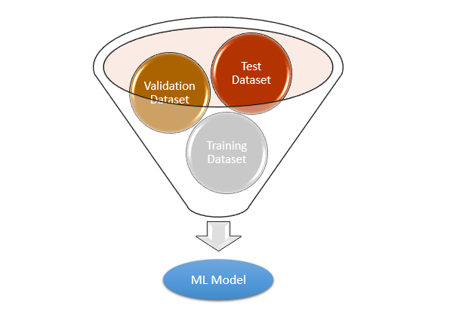
FYP-II Deliverables
SIR, Statistical Analysis and Base Paper Implementation | Model Implementation & Testing | Research Paper

Slide 3
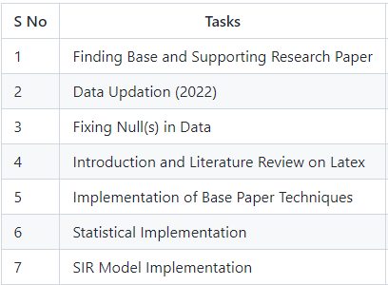
Our Progress

Slide 4
Statistical Implementation

Slide 5
Why Statistical Analysis?
Statistical analysis is a type of data analysis that
allows you to extract important insights from
unstructured and raw data. We utilize statistical
analysis because data visualization only provides
us an estimate, not an exact result, thus we use
statistical analysis to gather more information
about the relationship between dependent and
independent variables.

Slide 6
Insights from Statistical Analysis
Criteria for performing statistical analysis:
R-Squared and Adj. R-Squared close to 1 then it means that
model has been fitted well and there is no irrelevant feature
blowing overall model performance.
If R-Squared and Adj. R-Squared both values are far apart then i it means that you also include irrelevant feature.
F-Statistics > 1 and Prob(F-Statistics) < 0.05 shows that there is good linear relationship between Target/Dependent variable and other feature variables.
If p>|t| < 0.05 Relevant Feature
If p>|t| > 0.05 Irrelevant Feature

Slide 7
Insights from Statistical Analysis
We used that criteria to find relationships between Dependent and Independent variables we found which features or variables are relevant and non-relevant.
Relevant Features:
Confirmed Cases
Deaths
Recovered
ICU/Hospital Beds
Population
Mobility
Mask Usage etc.

Slide 8
Insights from Statistical Analysis
Non-relevant Features:
Pneumonia
Inf_lower, Inf_upper, Inf_mean
Seir_Daily_mean, Seir_Daily_upper
Admis_mean_vax, Admis_lower_vax, Admis_upper_vax
Admis_mean_unvax, Admis_lower_unvax, Admis_upper_unvax
Barometer, Wind

Slide 9
SIR Model Implementation

Slide 10
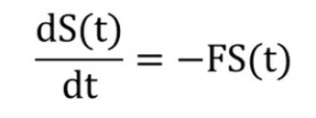
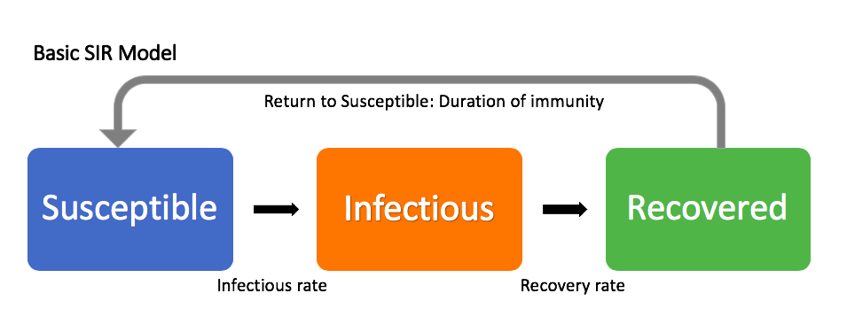
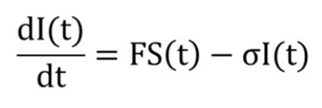
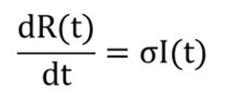
Why use SIR Model?
SIR model is a mathematical model to predict the spread of COVID-19.
In SIR model the population is divided into 3 different groups
S = Susceptible group (which can be infected by the COVID-19)
I = Infected group (which is infected by COVID-19 and can infect other)
R = Recovered group (which is infected by COVID-19)
SIR model is based on the differential equations. These equations are
‘

Slide 11
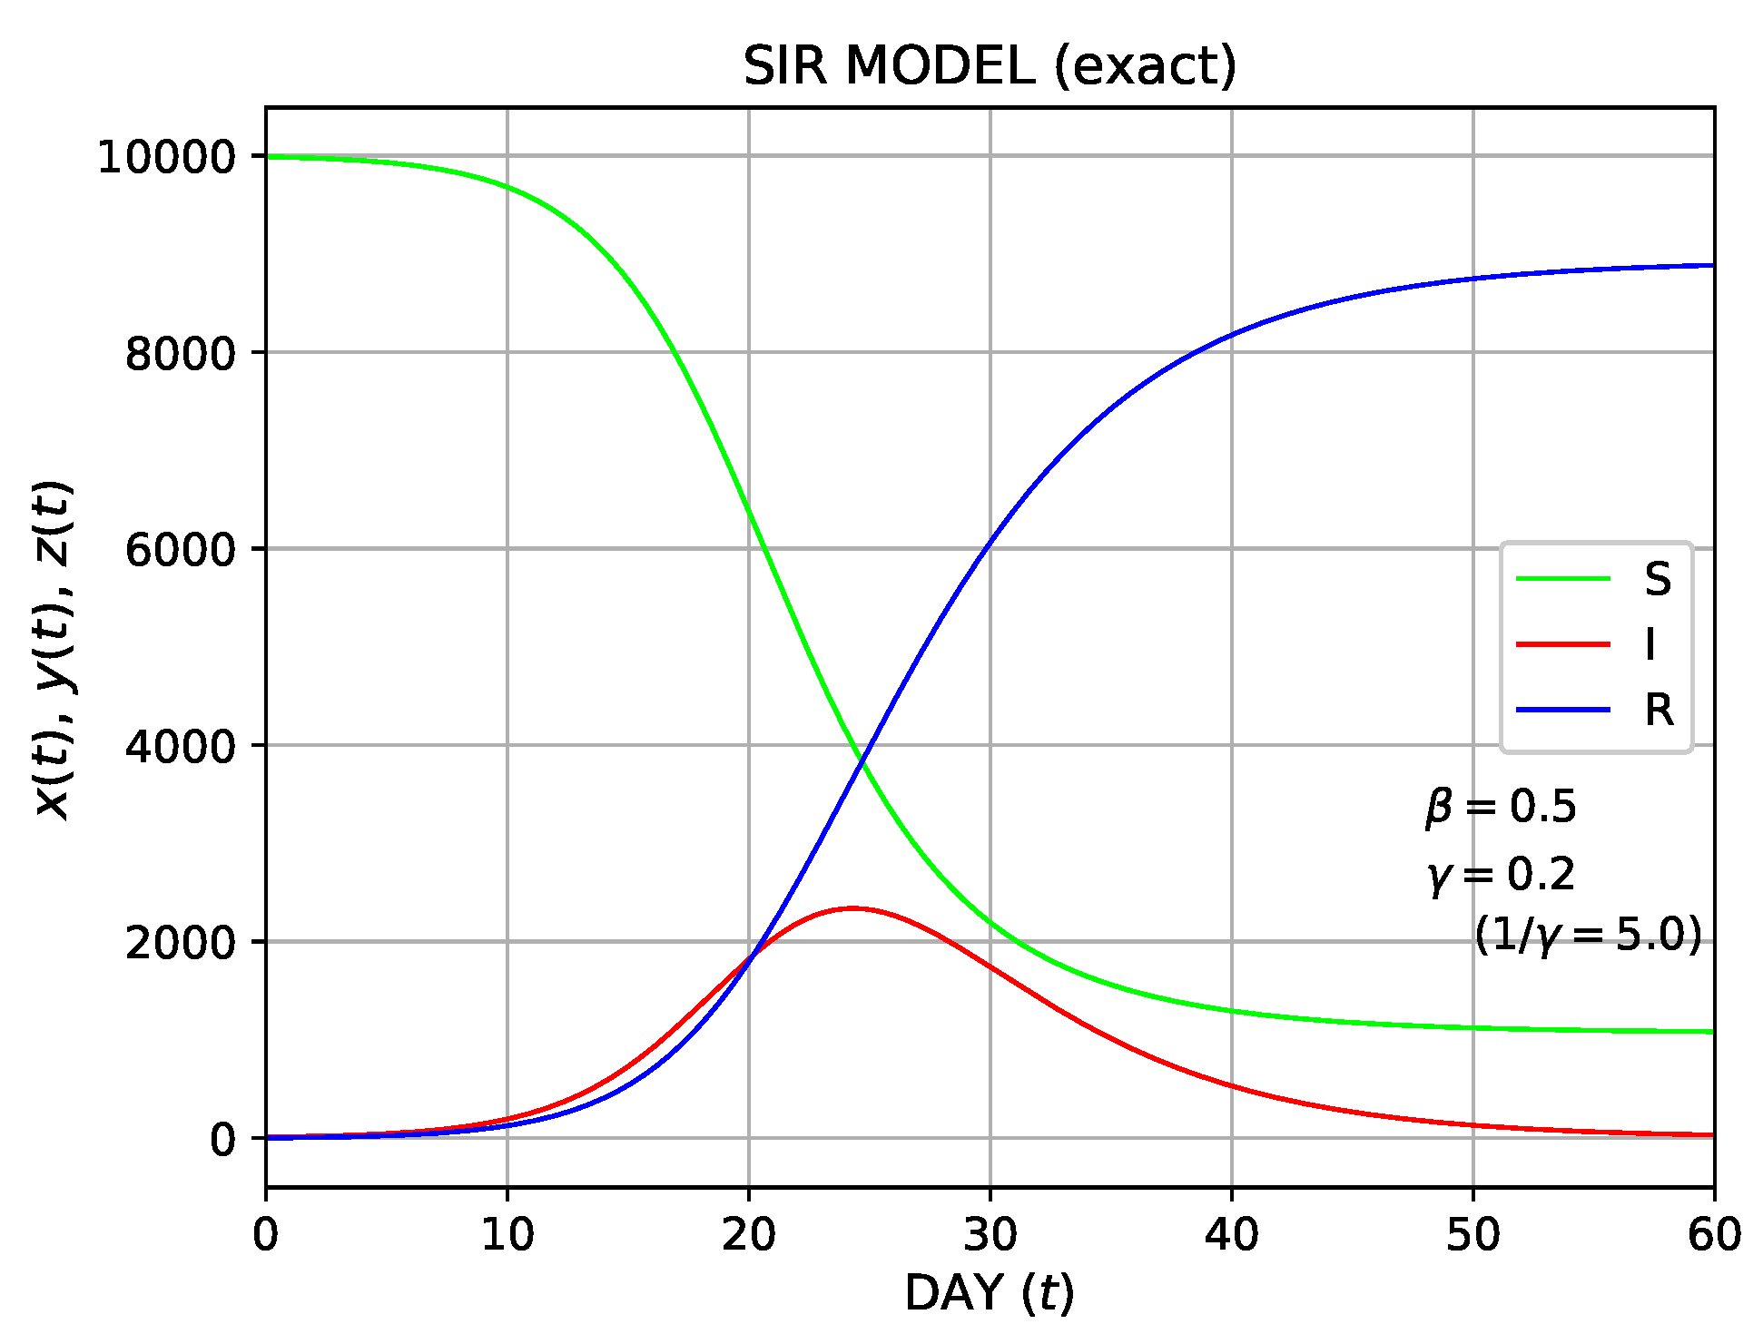
Insights from SIR Model
As time passes, the number of susceptible decreases where as infected increased and after sometime the recovered also starts to increase. At one point the the value of I will start to be negative or decrease as the number of newly infected will become lower than the number of recovered

Slide 12
Base Paper Implementation

Slide 13
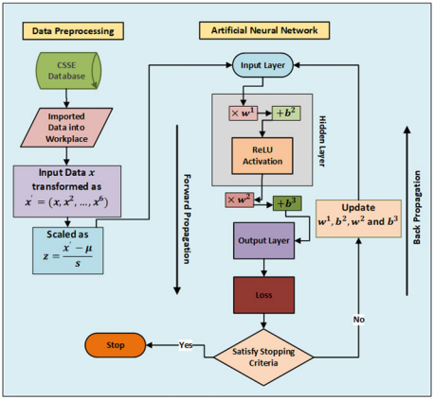
Methodology Summary

Slide 14
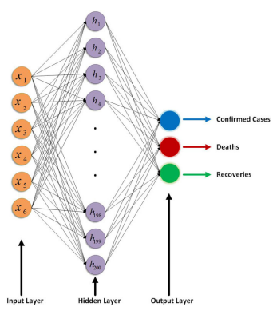
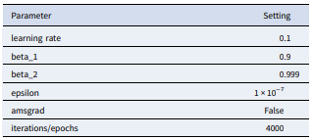
Model Architecture

Slide 15
References
1. Ahmad, Iftikhar, and Syed Muhammad Asad. "Predictions of coronavirus COVID-19 distinct cases in Pakistan through an artificial neural network." Epidemiology & Infection 148 (2020).
2. Hazbavi, Zeinab, et al. "Spatial and temporal analysis of the COVID-19 incidence pattern in Iran." Environmental Science and Pollution Research 28.11 (2021): 13605-13615.
3. Huang, Rui, Miao Liu, and Yongmei Ding. "Spatial-temporal distribution of COVID-19 in China and its prediction: A data-driven modeling analysis." The Journal of Infection in Developing Countries 14.03 (2020): 246-253.
4. Sartorius, B., A. B. Lawson, and R. L. Pullan. "Modelling and predicting the spatio-temporal spread of COVID-19, associated deaths and impact of key risk factors in England." Scientific reports 11.1 (2021): 1-11.
5. Mehmood, Khalid, et al. "Spatiotemporal variability of COVID-19 pandemic in relation to air pollution, climate and socioeconomic factors in Pakistan." Chemosphere 271 (2021): 129584.
6. Ali, Muhammad, et al. "Forecasting COVID-19 in Pakistan." Plos one 15.11 (2020): e0242762.

Slide 16
References
7. Waqas, Muhammad, et al. "Analysis and prediction of COVID-19 pandemic in Pakistan using time-dependent SIR model." arXiv preprint arXiv:2005.02353 (2020).
8. Ahmad, Iftikhar, and Syed Muhammad Asad. "Predictions of coronavirus COVID-19 distinct cases in Pakistan through an artificial neural network." Epidemiology & Infection 148 (2020).
9. Shwartz-Ziv, Ravid, Itamar Ben Ari, and Amitai Armon. "Spatial-Temporal Convolutional Network for Spread Prediction of COVID-19." arXiv preprint arXiv:2101.05304 (2020).
10. Gao, Junyi, et al. "STAN: spatio-temporal attention network for pandemic prediction using real-world evidence." Journal of the American Medical Informatics Association 28.4 (2021): 733-743.
11. Nikparvar, Behnam, et al. "Spatio-temporal prediction of the COVID-19 pandemic in US counties: modeling with a deep LSTM neural network." Scientific reports 11.1 (2021): 1-12.
12. Vahedi, Behzad, Morteza Karimzadeh, and Hamidreza Zoraghein. "Spatiotemporal prediction of COVID-19 cases using inter-and intra-county proxies of human interactions." Nature communications 12.1 (2021): 1-15.

Slide 17
References
13. Sarwar, Suleman, et al. "COVID-19 challenges to Pakistan: Is GIS analysis useful to draw solutions?." Science of the Total Environment 730 (2020): 139089.
14. Saeed, Urooj, et al. "Identification of potential lockdown areas during COVID-19 transmission in Punjab, Pakistan." Public health 190 (2021): 42-51.
15. Raza, Ali, et al. "Association between meteorological indicators and COVID-19 pandemic in Pakistan." Environmental Science and Pollution Research 28.30 (2021): 40378-40393.
16. Khakharia, Aman, et al. "Outbreak prediction of COVID-19 for dense and populated countries using machine learning." Annals of Data Science 8.1 (2021): 1-19
17. Rustam, Furqan, et al. "COVID-19 future forecasting using supervised machine learning models." IEEE access 8 (2020): 101489-101499.
18. Yousaf, Muhammad, et al. "Statistical analysis of forecasting COVID-19 for upcoming month in Pakistan." Chaos, Solitons & Fractals 138 (2020): 109926.
19. Iqbal, Muhammad, et al. "COVID-19 patient count prediction using LSTM." IEEE Transactions on Computational Social Systems 8.4 (2021): 974-981.
20. Bag, Rakhohori, et al. "Understanding the spatio‐temporal pattern of COVID‐19 outbreak in India using GIS and India's response in managing the pandemic." Regional Science Policy & Practice 12.6 (2020): 1063-1103.

